Slide 1
INVENTORY MANAGEMENT SYSTEM
Ishmal Farooq(2023-uam-4601)
Ayesha Ayoub(2023-uam-4605)
Aleena Ansari(2023-uam-4615)
Maryam Hassan(2023-uam-4620)

Slide 2
PROJECT DESCRIPTION
This C++ application is a basic inventory and sales management system. This is a synopsis of its structure and functionality:
1.Product Class: Depicts a product together with its name, ID, quantity, and cost.
2.Inventory Class: It enables the inventory to be expanded and shows every item that is presently in stock.
3.Customer Class: Contains the name and address of a customer. It has a way to show client information.
4.Order Class: A customer's order is represented by this class. It includes a list of the products that were ordered as well as the customer's details.
5.Main Function: The program's entrance point is the main function. It employs exception handling to gently manage mistakes.
6.Data Structures: Arrays are used by the application to store customer orders and inventory items.

Slide 3
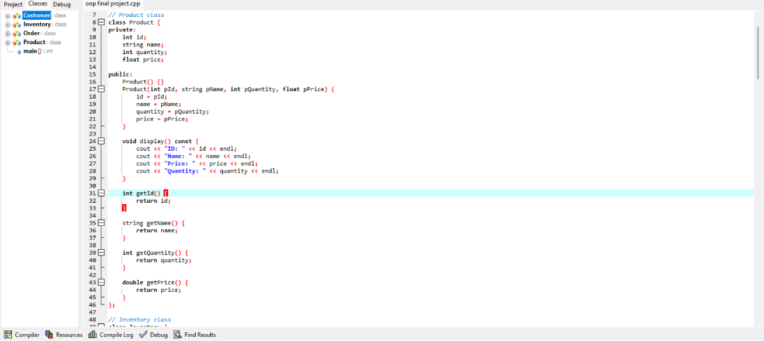
PRODUCT CLASS
THE PRODUCT CLASS encapsulates the data related to a product and provides methods to access and display this data. It follows the principles of encapsulation by hiding internal details and providing controlled access to its attributes.

Slide 4
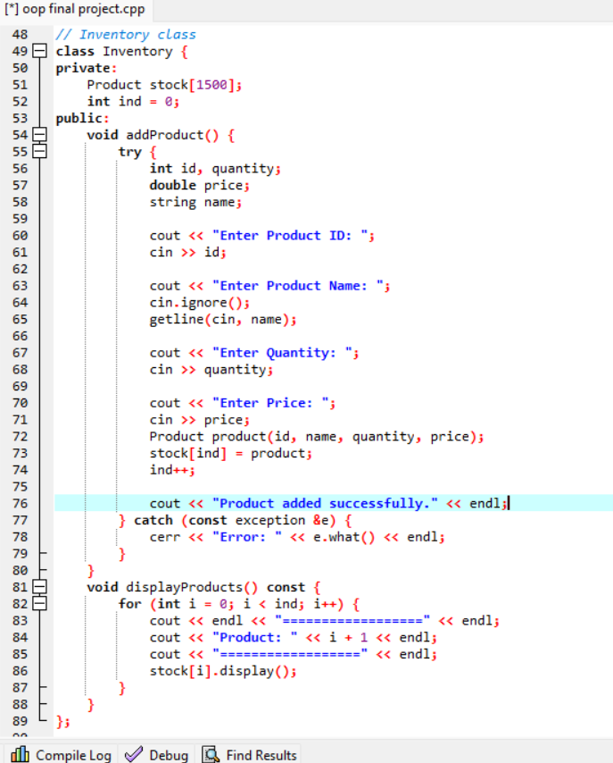
INVENTORY CLASS
The PRODUCT CLASS manages the storage and display of product data in the inventory. It encapsulates the inventory data, provides methods for adding products and displaying them, and includes error handling to handle potential exceptions during product addition.

Slide 5
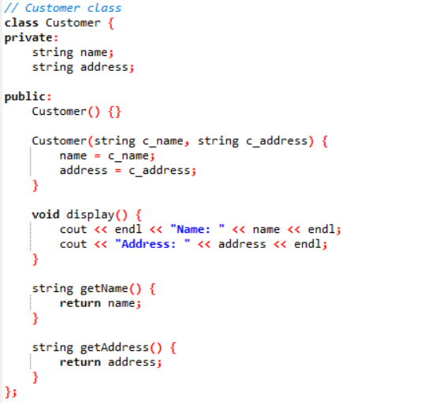
CUSTOMER CLASS
The CUSTOMER ClASS represents a customer entity with attributes for name and address. It provides methods to access and display customer details and follows encapsulation principles by keeping its attributes private and providing controlled access through principles.

Slide 6
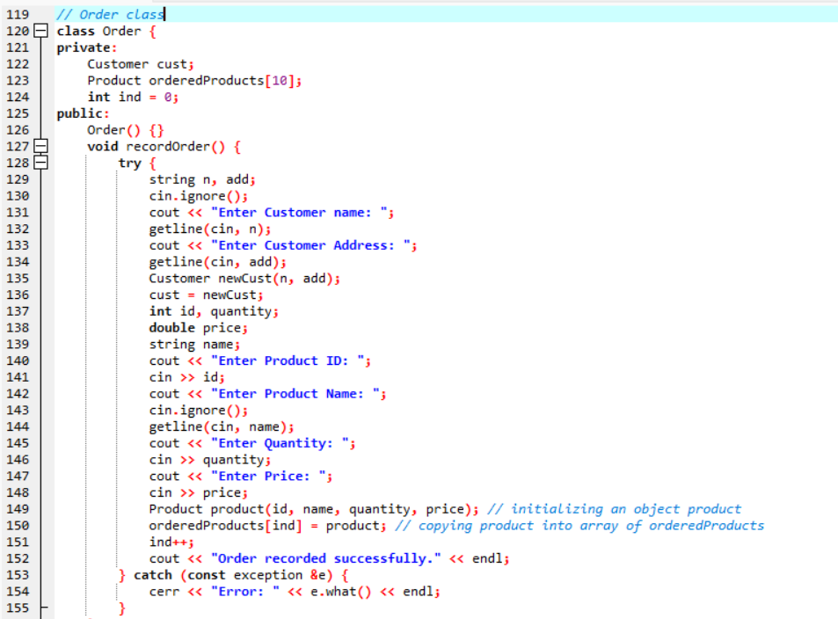
0RDER CLASS
The ORDER CLASS manages the recording and display of orders. It encapsulates the order data, provides methods for recording orders and displaying order details, and includes exception handling to handle potential errors during order recording.

Slide 7
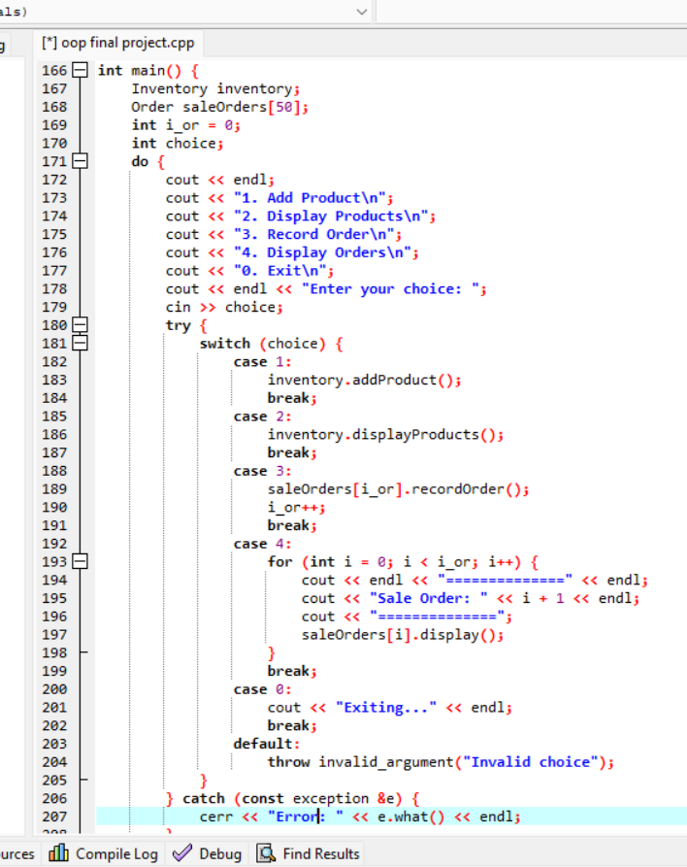
MAIN FUNCTIONALITY

